Slide 1
Traveler Registration with International SOS for Loyola Marymount University

Slide 2
Table of Contents FOR STUDENTS: Creating a profile within My Trips Submitting Travel Itinerary FOR FACULTY & STAFF: Submitting Travel Itinerary

Slide 3
Travel Itinerary Registration Process for Students/ Study Abroad

Slide 4
Create a MY TRIPS Profile
The My Trips profile will ensure that any travel itineraries registered into Tracker will match the student profile data to ensure the University can communicate with the traveler as needed via email and text when issues may arise.
The My Trips account also provides access for the student/traveler to modify their trip details
LMU Students and Study Abroad Participants to create a My Trips Profile with International SOS. Steps to create a My Trips Profile are on the following 2 slides.

Slide 5
How to create a MyTrips Profile

Slide 6
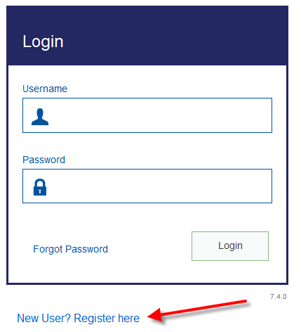
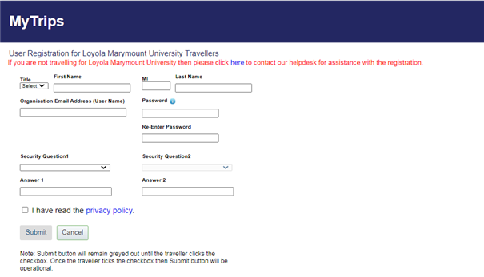
MyTrips – How to register for an account
https://MyTrips.travelsecurity.com/Login.aspx?ci=9ztoYcjAJCg%3d

Slide 7
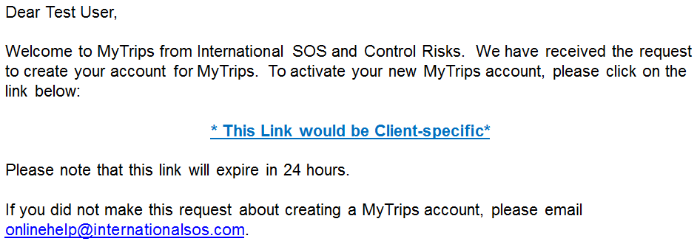
MyTrips – Let’s keep it going…

Slide 8
Register Travel Itinerary with XXXX
Upon completion of booking your Study Abroad travel itinerary, please send a copy of the itinerary to XXXXX. This will ensure your travel is fully registered with LMU Study Abroad.
For any travel excursions, or weekend itineraries booked while studying abroad, please also send those itineraries to XXXXX to ensure registration with LMU.

Slide 9
Travel Itinerary Registration Process for Faculty and Staff

Slide 10
Registering Travel Itineraries with LMU
We are happy to announce that our new Travel Registration Process is now live!
You can now forward your itinerary email confirmations to an email-box specifically created for LMU Travel Registration. Please forward your trip confirmation emails to LMUTravel@itinerary.internationalsos.com and your trip details will be processed into our system.
After we process your confirmation emails we will send you a notification email informing you of the status of your Itinerary. *Note: You may notice a slight delay if the Itinerary Forwarding Service does not recognize the vendor.
Successfully registering the tinerary into our system
If your itinerary is processed successfully, you will receive a confirmation email noting this.
Could not load the Itinerary into our system
- If your confirmation email failed to process, there are several possible reasons for this:
We are unable to read the format
There are missing data elements that are required to process the itinerary into our system
Attachments are missing. Some Itineraries require attachments, so please ensure you forward any attachments which are included in the original confirmation email
Things to Note
• Only flight, hotel and car rental bookings can be forwarded to the mailbox. Train bookings are not supported at this time.
• You should forward the original confirmation email without making any changes to the email. If you change the original email content or format, the trip details will not get processed. For example, if you receive two separate confirmation emails for two different trips, you should forward each original confirmation email to the mailbox separately.
• If the confirmation email includes a PDF document, please include the PDF document when forwarding the confirmation email.
• If you make a change to the itinerary, please forward the latest version of the itinerary confirmation email to the mailbox.
• If you cancelled the trip through a vendor, you will need to create a MyTrips account (https://https://MyTrips.travelsecurity.com/Login.aspx?ci=9ztoYcjAJCg%3d) in order to log in and remove the trip from the trip list.
If you require any assistance with the itinerary forwarding service, please contact the International SOS Online Help team at onlinehelp@internationalsos.com and they will be happy to assist.

Slide 11
Communicating with the Travelers

Slide 12
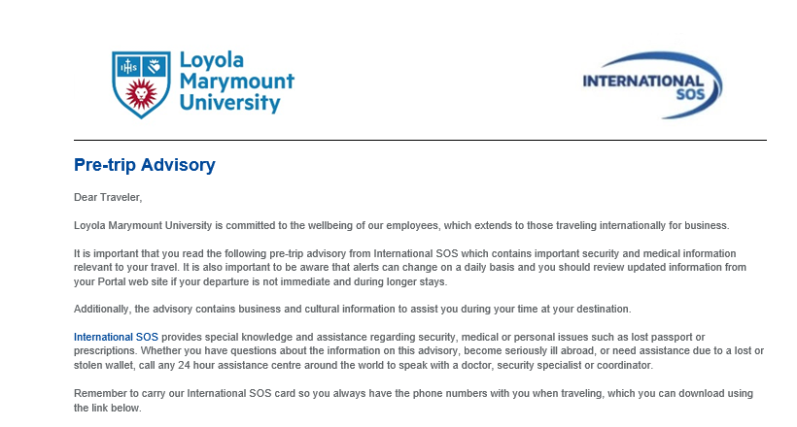
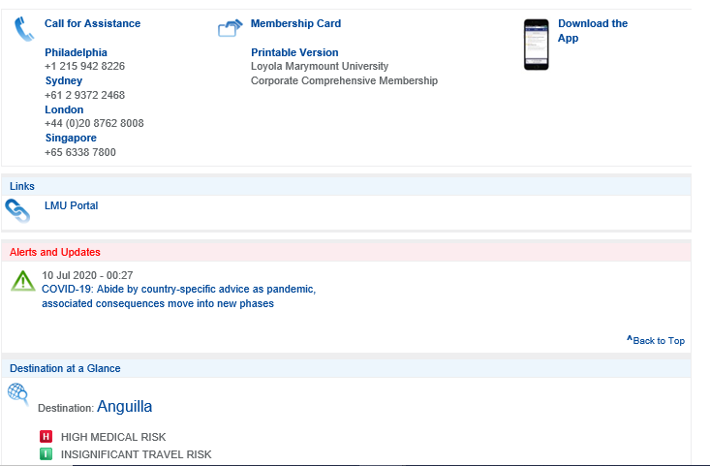
Pre-Trip Advisory Upon registration of your travel itinerary, you will receive a destination specific advisory highlighting the medical and security resources available to you while abroad.

Slide 13
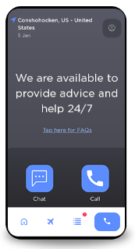
International SOS 24/7 Assistance Center Support
Download Assistance APP
Scan to Download the International SOS Assistance App This will provide 1 click dialing to the nearest 24/7 Assistance Center for any medical or security support needs related to your LMU international travel
International SOS-LMU Website
Visit the International SOS – LMU website to explore health and safety information for your international travel destination

Slide 14
END

